Slide 1



Slide 2

Dairy Dreaming and Complain Service Facility App
Supervised by:
Miss Mehreen Wahab
Group Members:
Awais Hafeez (FA19-MCS-016)
Nauman Shehzad (FA19-MCS-007)
Department of Computer Science
COMSATS University Islamabad, Attock Campus

Slide 3
Outline
Introduction
Working flow
Comparison table
Problem statement
Objectives
Interface
Methodology
Modern tools
Benefits
References
_______________________________

Slide 4

Introduction
In human’s life, milk is considered an important ingredient for existence. It is not available at such quantity which is enough for everyone.
The insufficient amount may cause starvation in many areas. The app is responsible for solving such type of issues.
In the app, Simple customer or Wholesaler will enter their request in the nearest farm for buying Milk (of particular animal) as well as buying Animals of particular kind.
The user may have a choice to receive order online or offline via location provided by the Google Map.
User may also have a facility to complain or report to Food Authority for the bad quality or bad standard of milk.
_______________________________

Slide 5
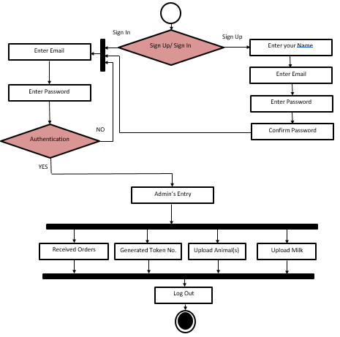
Working flow
Farm Owner:
_______________________________

Slide 6
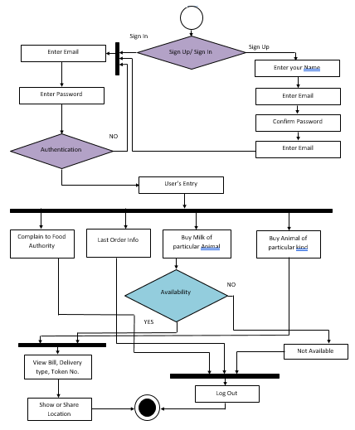
Working flow
User:
_______________________________

Slide 7
Applications and Comparison Table
Features | Dairy Product Services | Farm Ghar | Dairy Dreaming and Complain Service Facility App (Proposed)
Online Delivery | ✔ | ✔ | ✔
Offline Delivery | ✖ | ✖ | ✔
Selling Milk of Different Nature | ✔ | ✖ | ✔
Selling Animals of Different Nature | ✖ | ✔ | ✔
Facility to Complain to Food Authority by the User | ✖ | ✖ | ✔
Generating Token No. Automatically for Offline Delivery | ✖ | ✖ | ✔
_______________________________

Slide 8
Problem statement
To provide an easy and predictive search of nearest farm on the basis of order via offline or online delivery.
To provide the facility to the user to complain to Food Authority in case he/she not satisfied with the quality/standard of milk.
The user will see the acknowledgement of his/her request quickly based on the nature of the order without visiting the farm first.
To provide facility to User to not only buy milk but also to buy the animal of particular kind and see its info such as image, price, age etc. as well.
Problems:
Q.1. How to find approval/disapproval of user’s request of milk or animal ?
Q.2. How to find nearest farm on the basis of User’s order?
Q.3. How the user will receive his/her order i.e., offline or online.
Q.4. How to Complain to Food Authority.
_______________________________

Slide 9
Objectives
The main goal and objective of the application is to save user’s precious time by checking quickly the availability or unavailability of his/her request in the nearest current farm.
To help the Farm Owner to hold the record of all the user’s requests in his/her database (Firebase).
To provide an online as well as offline delivery of the order to the user.
To provide the user, a facility to complain to Food Authority for the bad quality or standard of milk of particular farm.
To provide availability of the product 24/7 hours a day.
_______________________________

Slide 10
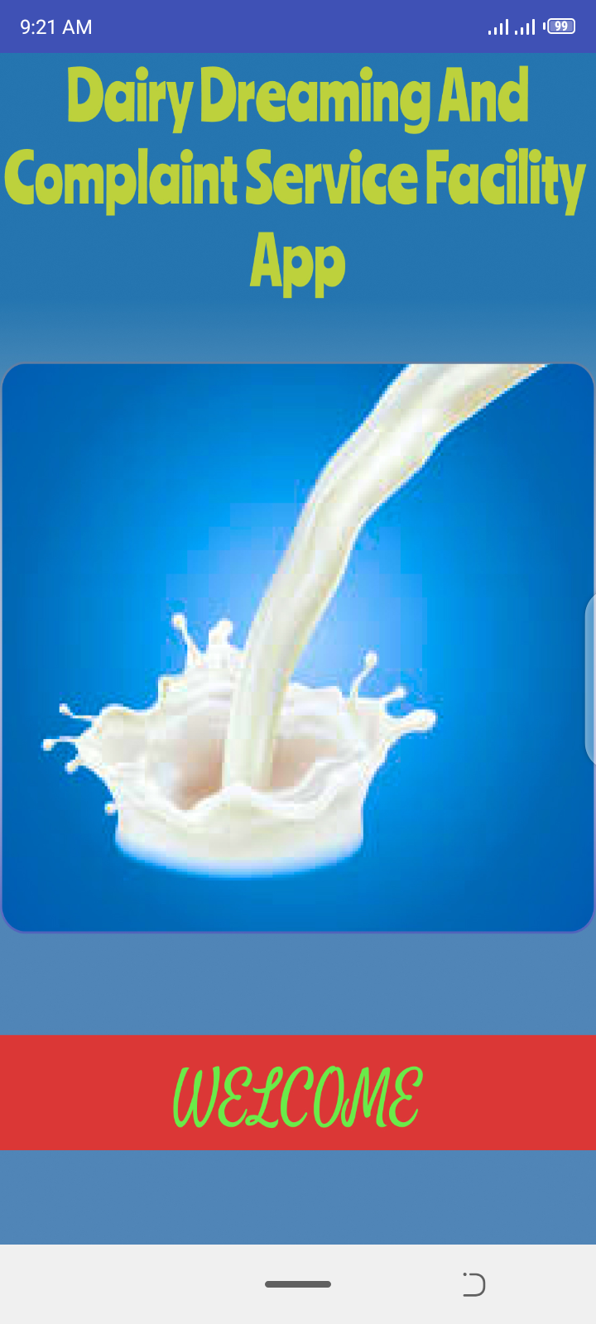
Splash Screen
Splash Screen is the first graphical interface you see when you visit any app. It appears only for short amount of time (e.g., 1s, 2s, 3s etc.) and then disappears automatically and then you see the next activity of the app.
The splash screen for this app is given:
_______________________________

Slide 11
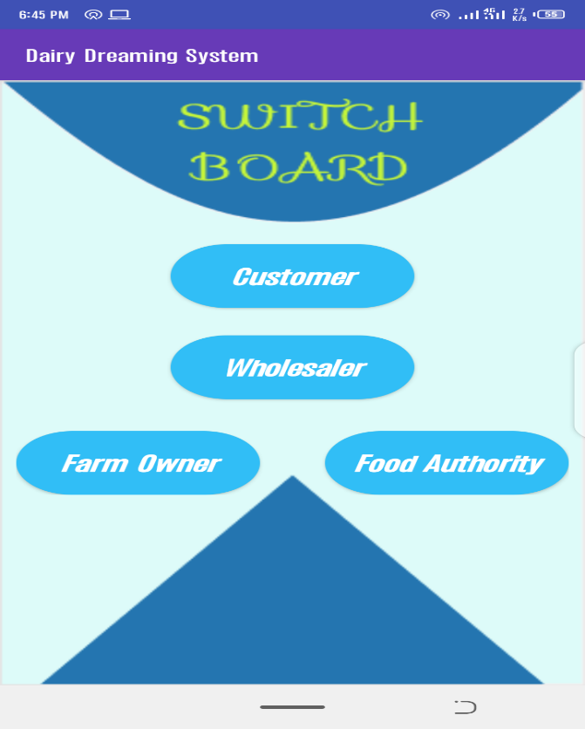
Switch Board
Switch board/ Dashboard allows the user to use the app according to his/her status either he/she is Farm Owner, Simple Customer, Wholesaler or belong to Food Authority.
Switch board/Dashboard for this app is given:
_______________________________
11

Slide 12
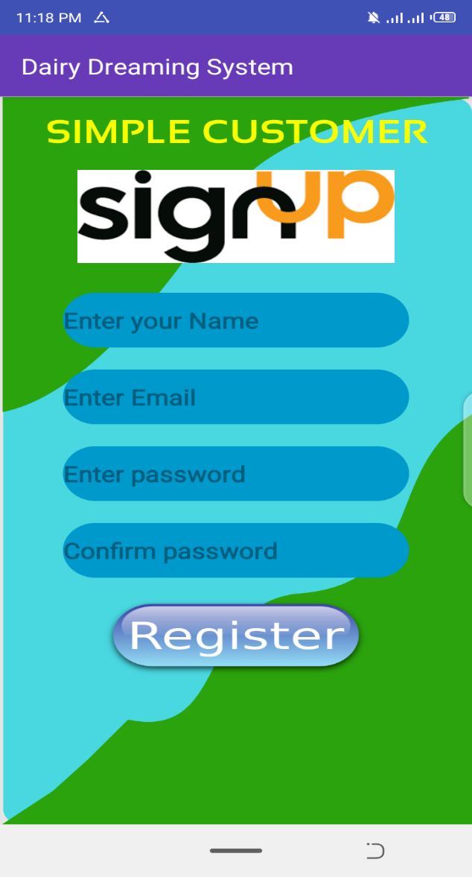
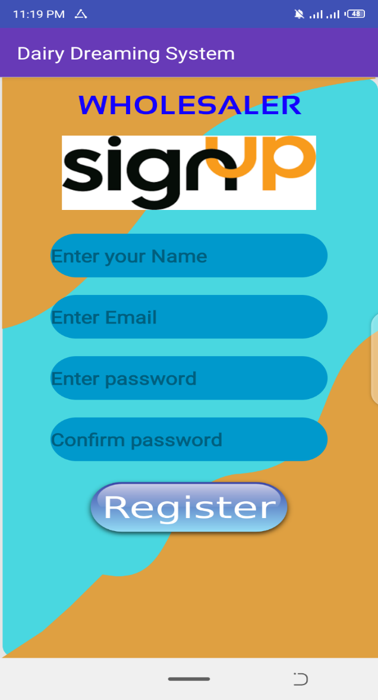
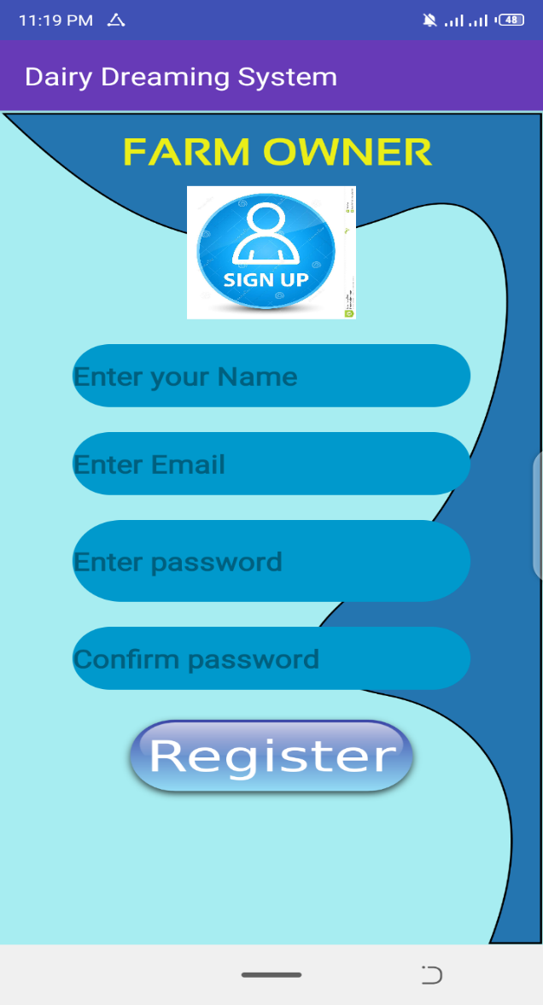
Interfaces
Sign Up Activity: (Farm Owner, Simple Customer, Wholesaler)
Sign Up activity is used to register the all the users in the system for the very first time they make appearance in the app. Sign Up activities of Simple Customer, Wholesaler and the Farm Owner are given below:
_______________________________
12

Slide 13
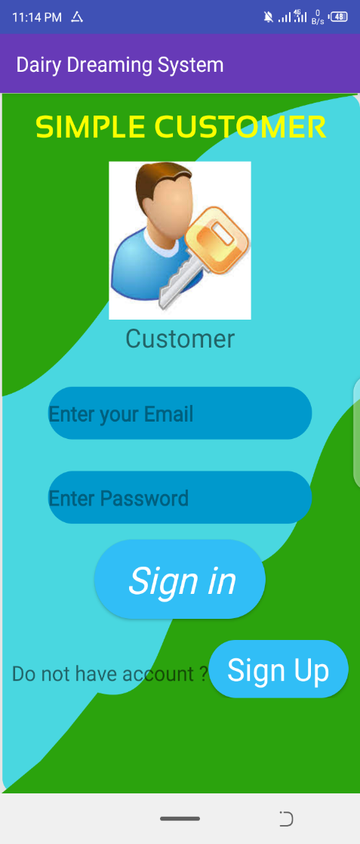
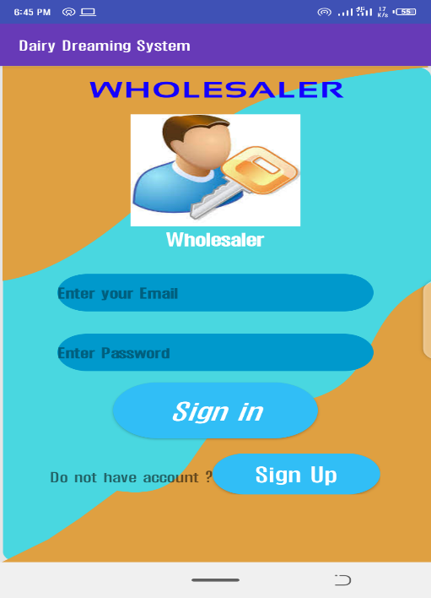
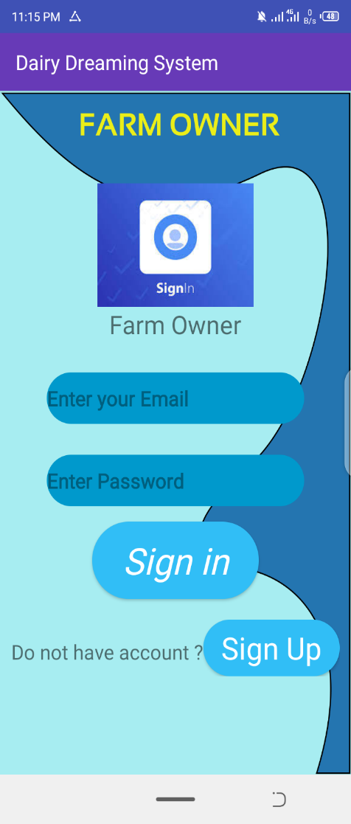
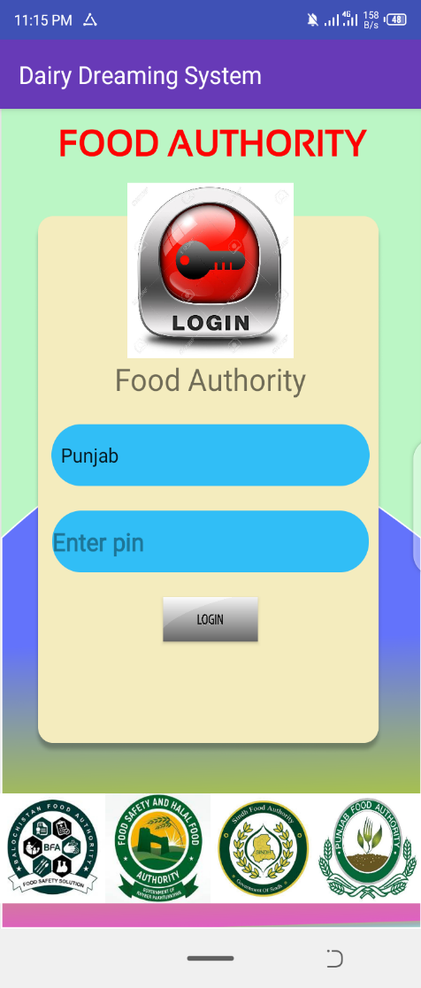
Interfaces
Sign In Activity: (Farm Owner, Simple Customer, Wholesaler, Food Authority)
Sign In activity is used to serve the users that are already registered in the system by having their correct Name, Password and Email etc. Sign In activities of Simple Customer, Wholesaler and the Farm Owner are given below:
_______________________________
13

Slide 14
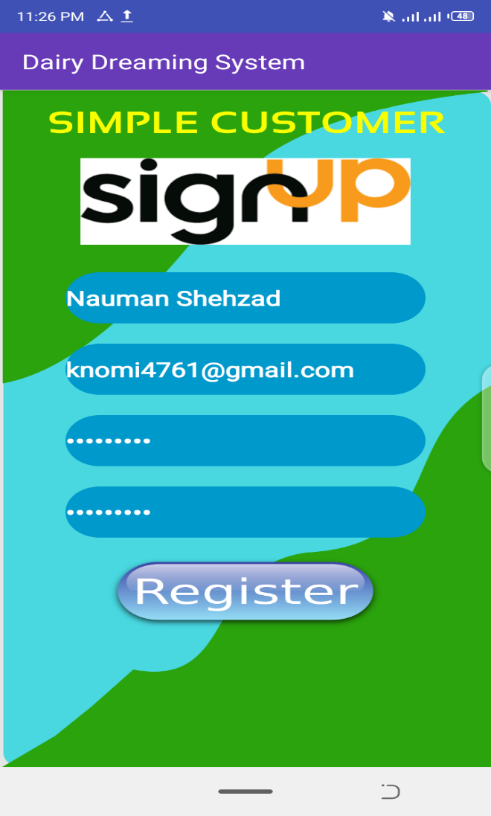
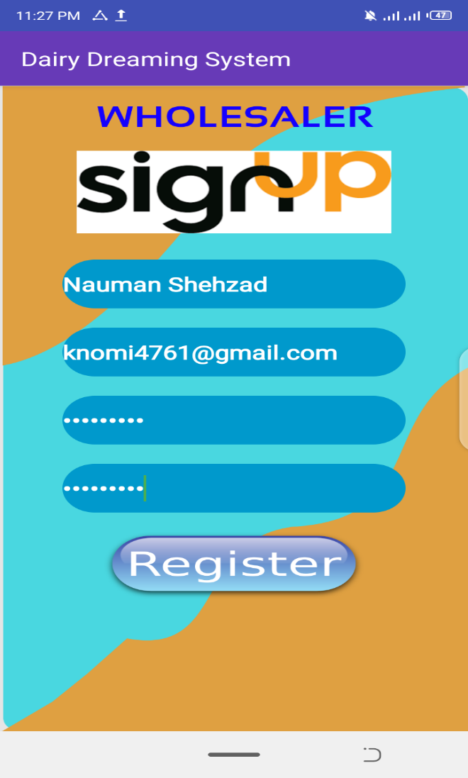
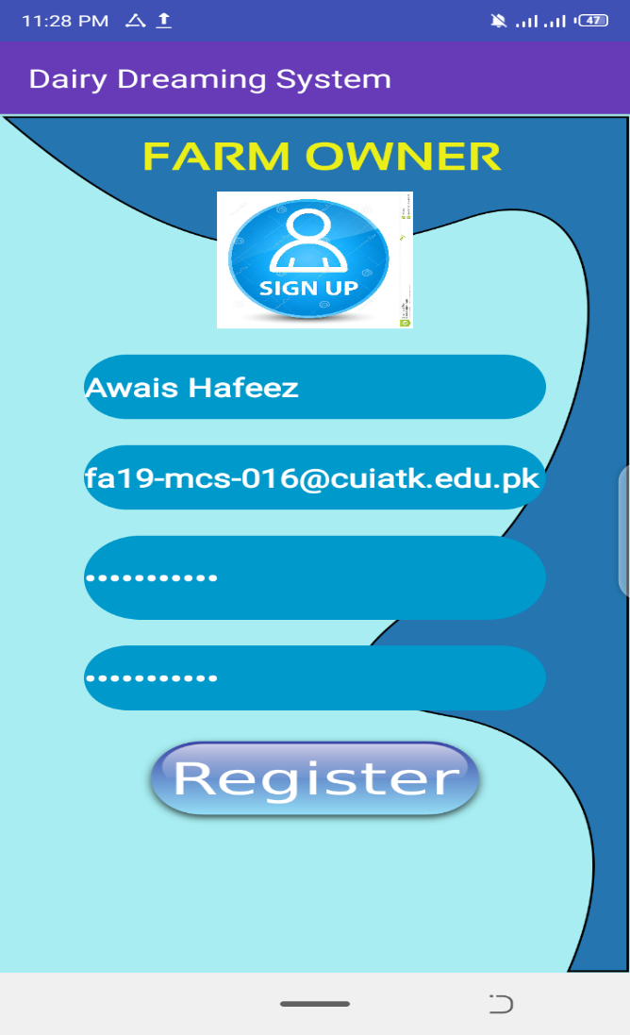
Filling Credentials
Sign Up Credentials:
Sign up credentials of Simple Customer, Wholesaler, Farm Owner require Name, Email, Password and Confirm Password. Filling of all the Credentials in all the Sign Up activities of this app are shown below:
_______________________________
14

Slide 15
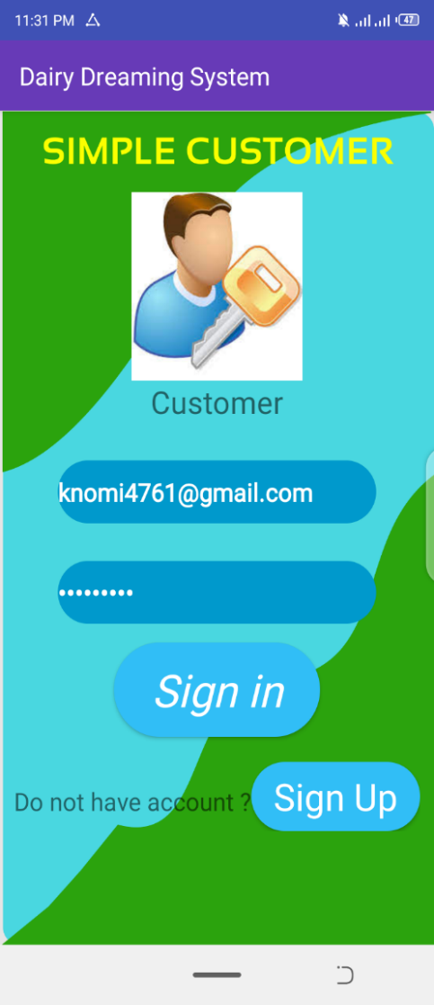
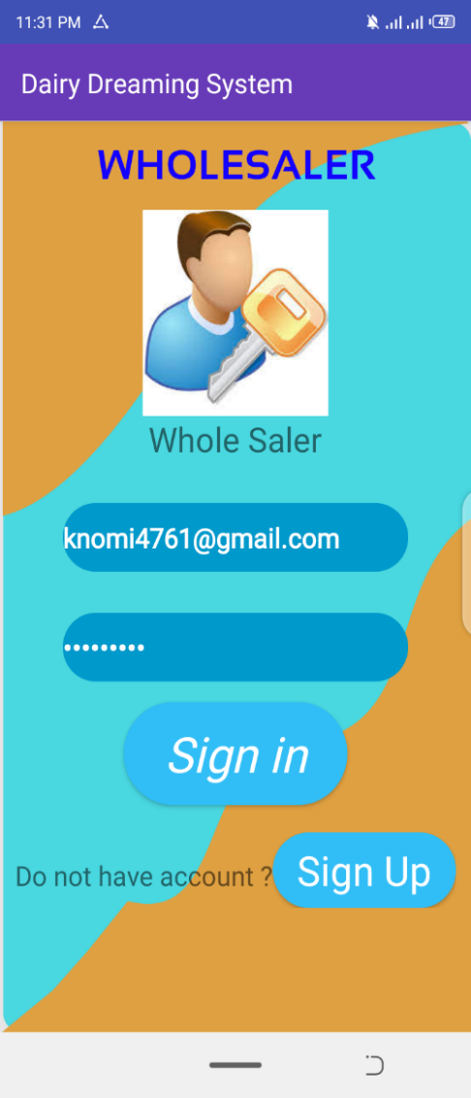
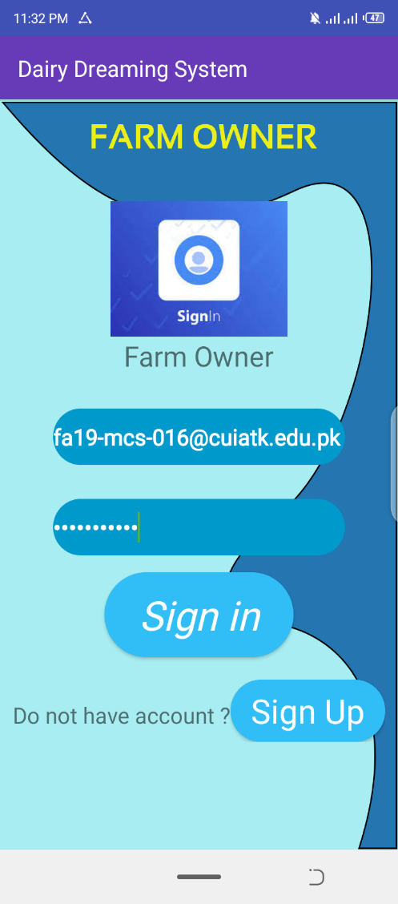
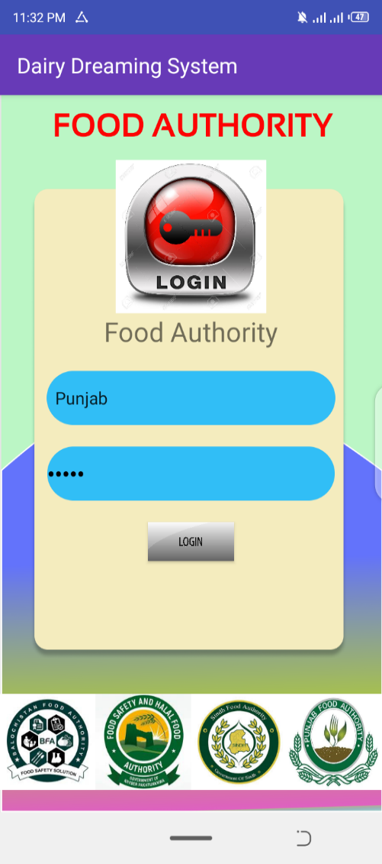
Filling Credentials
ii. Sign In Credentials:
Sign in credentials of Simple Customer, Wholesaler, Farm Owner require Email and Password. Filling of all the Credentials in all the Sign Up activities of this app are shown below:
_______________________________
15

Slide 16
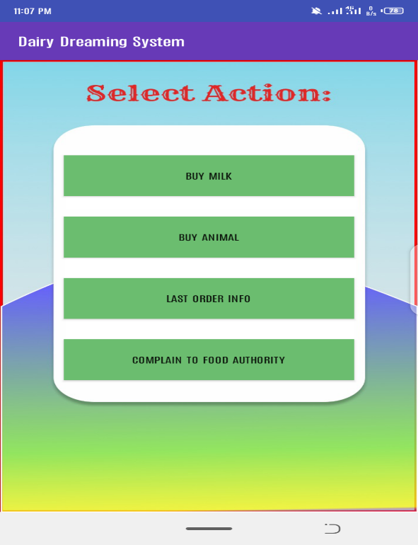
Interfaces
User Interface:
When the user sign up/sign in to the app the activity below will be shown to the user. In which, he/she has different selection options.

Slide 17
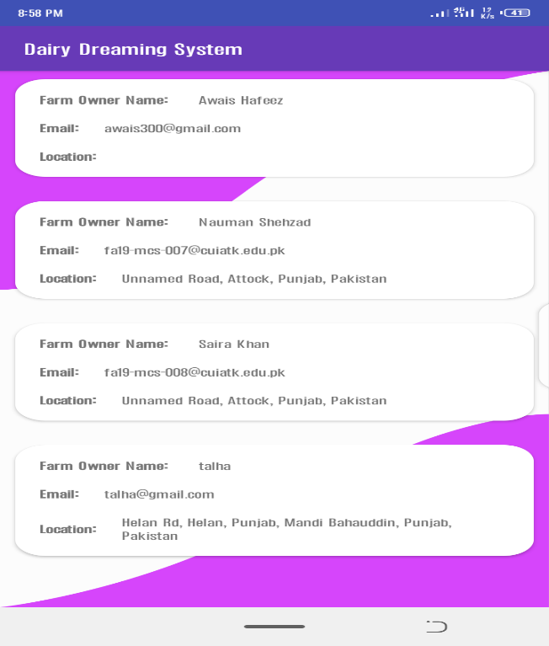
Interfaces
List of all Available Farms shown to the User:
For buying a product, the list of all available farms will be shown to the user as:

Slide 18
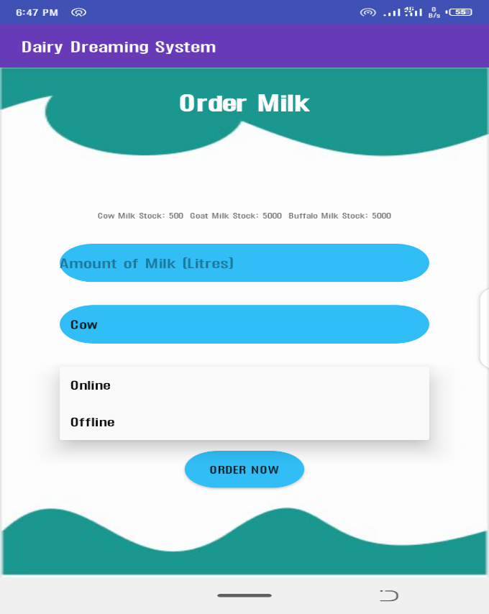
Interfaces
Ordering of Milk:
The ordering activity of Milk for the user is shows below. In which, he/she has to enter his order (amount of Milk in litres) and also to select the delivery type either offline or online.

Slide 19
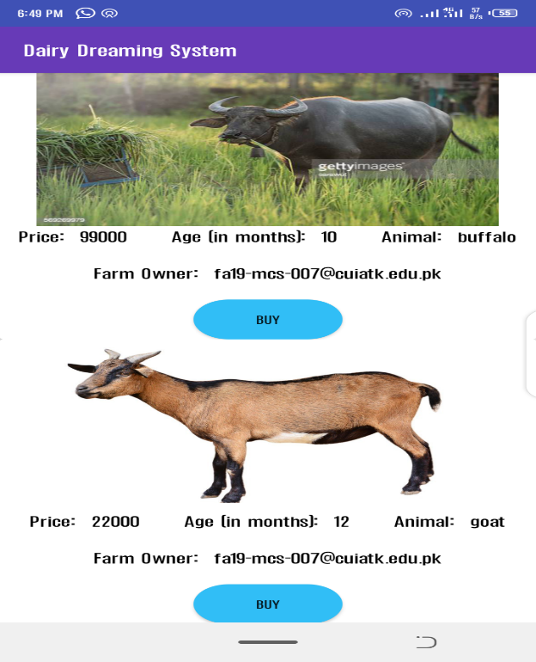
Interfaces
Ordering of Animal:
The ordering of Animal activity for the user is shown below. In which, the user has to select the particular animal to buy from the particular farm with the given price, age and image. The type of Animal is also shown to the user.

Slide 20
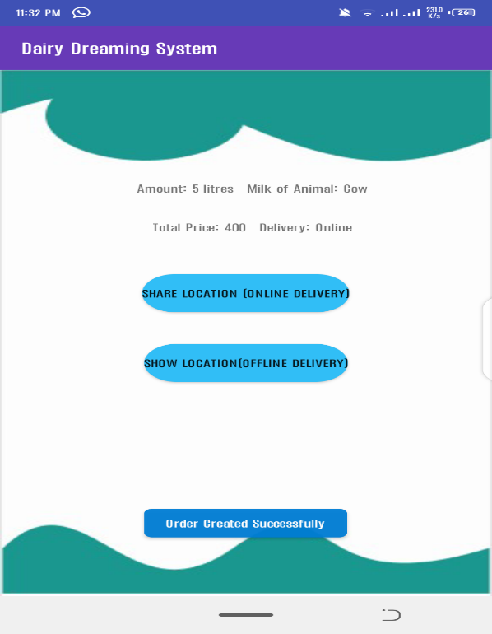
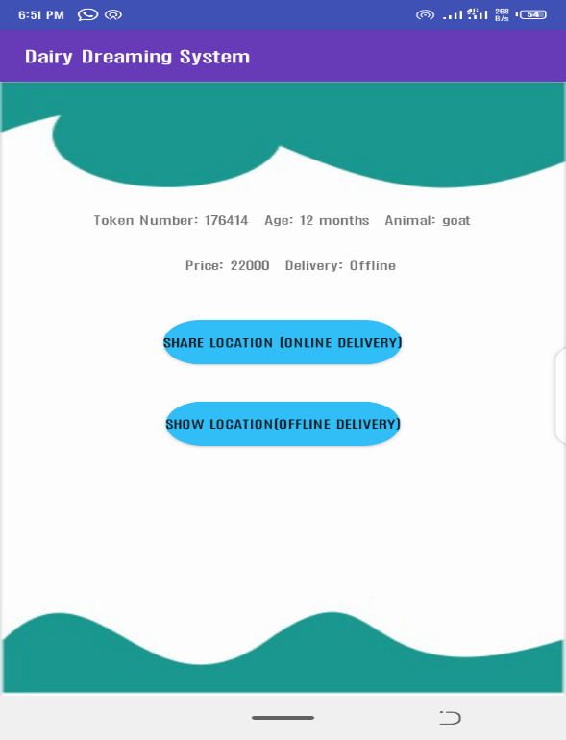
Interfaces
Sharing of Location:
The sharing of location is completely dependent on the delivery method choose by the user. For the offline delivery, the location of the Farm will be shown and for the online delivery, the location of the User will be shown as:

Slide 21
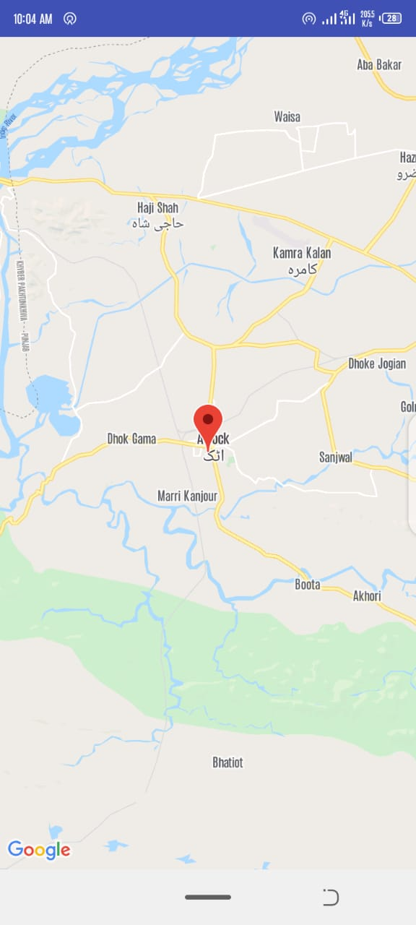
Interfaces
Location of the Farm for Offline delivery is shown below:

Slide 22
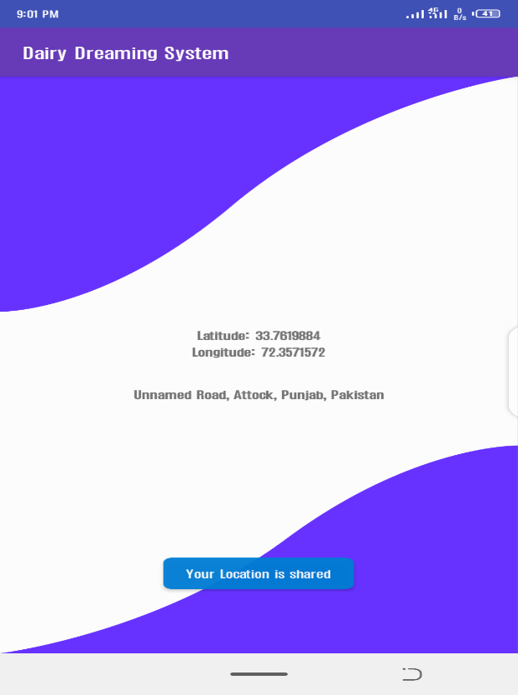
Interfaces
Location of the User for Online delivery is shown below:

Slide 23
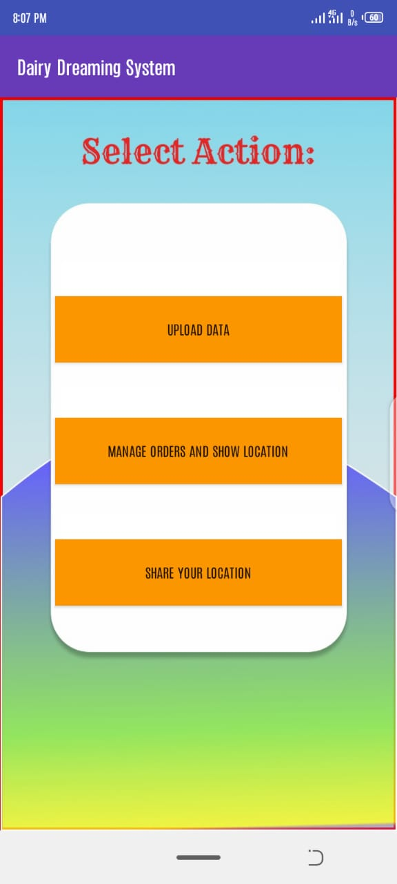
Interfaces
Farm Owner :
When the Farm Owner sign up/sign in to the app the activity below will be shown to the user. In which, he/she has different selection options.

Slide 24
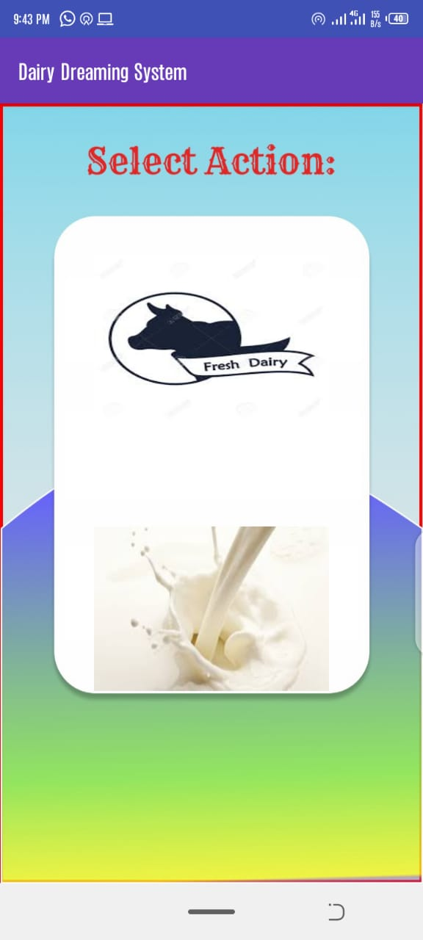
Interfaces
Uploading of Data by Farm Owner:
The activity for the Farm Owner for the uploading of Data is shown below. In which, he/she upload either Milk data of upload Animal(s).

Slide 25
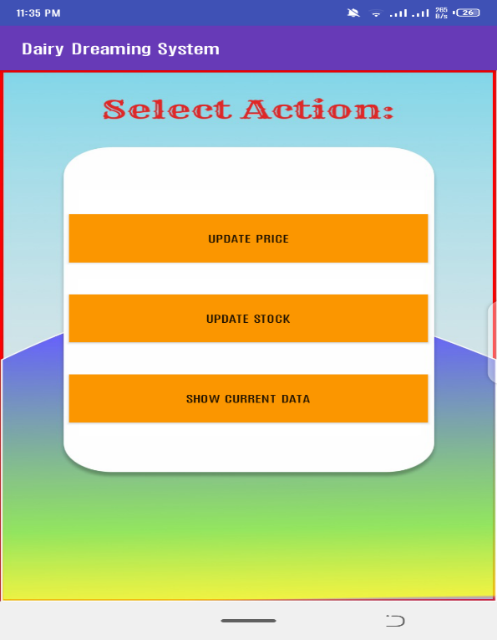
Interfaces
Uploading of Milk and Updating of Stock :
The activity for the uploading of Milk and updating of Stock for the Farm Owner is shown below. In which, the farm owner can upload the stock available and update the price of each Milk type as well as can view the current data of Milk.

Slide 26
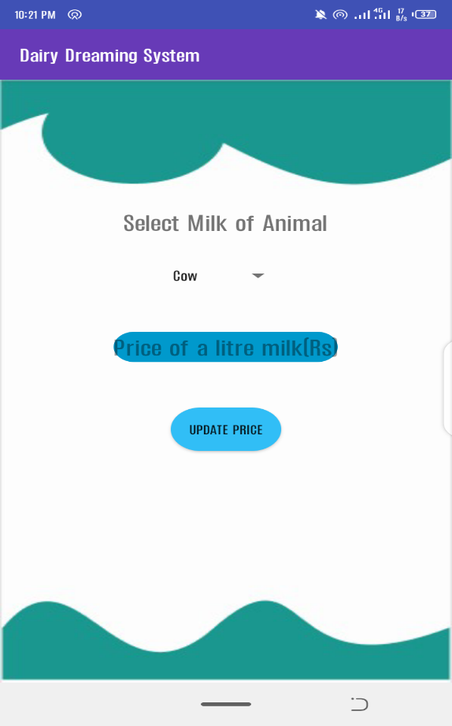


Interfaces
Upload or Update price of each Milk type:
The activity for the uploading of updating of each Milk type is shown below. In which, the farm owner can update or upload the price of each Milk type per Litre.

Slide 27
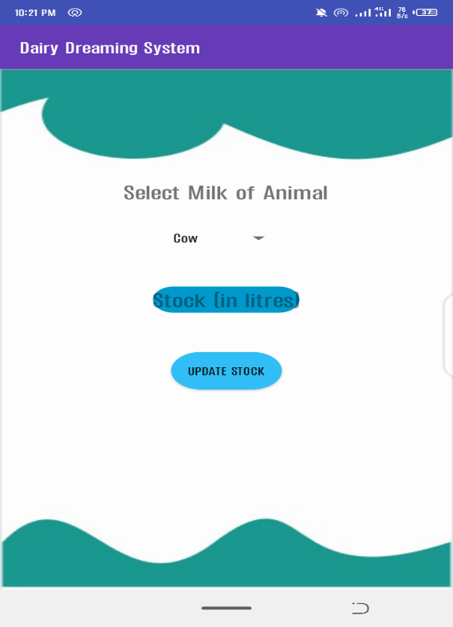
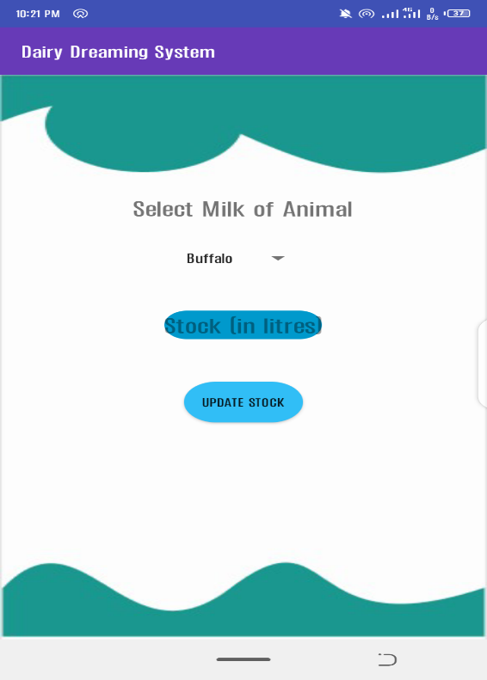

Interfaces
Update price of each Milk type:
The activity for the updating of stock of each Milk type is shown below. In which, the farm owner can update the stock of each Milk type in Litres.

Slide 28
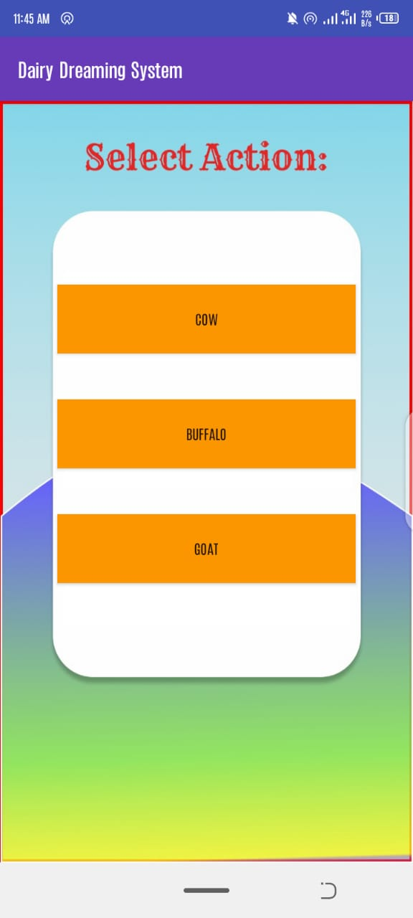
Interfaces
Upload Animal:
The Farm Owner can upload 3 types of Animals cow, buffalo and goat. The activity for the selection of uploading of each animal is shown below.

Slide 29
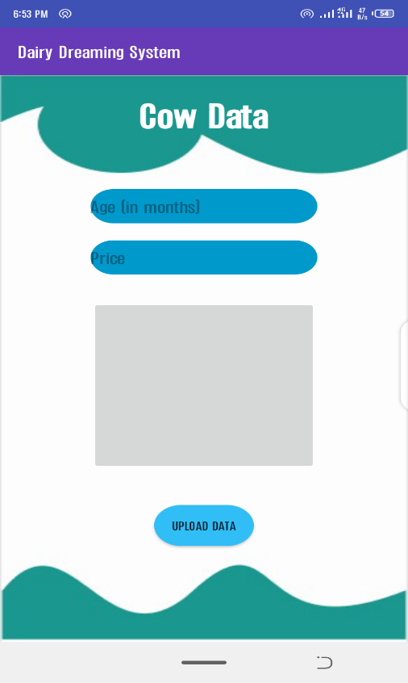


Interfaces
Upload info of each Animal:
The farm owner has to upload the Age, Price and Image for the each animal to upload. The activity for this info is shown below.

Slide 30
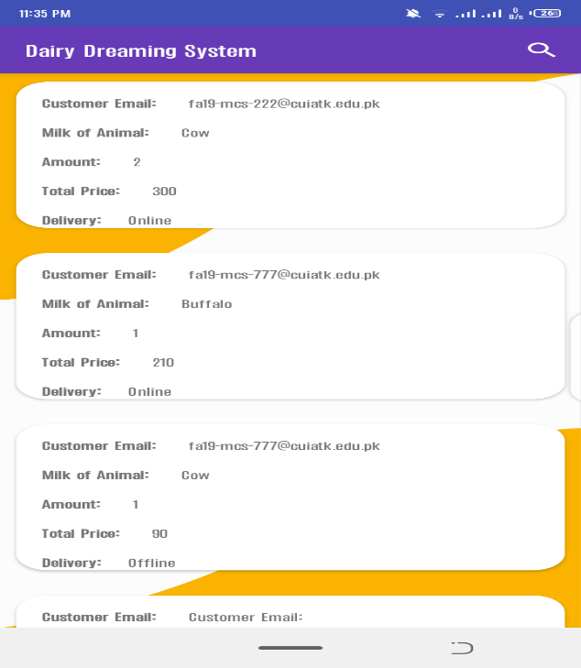
Interfaces
Orders of Milk:
The orders of Milk of a specific Farm is shown below. In which, the Farm Owner can see the Customer Email, Milk of Animal, Amount, Total Price and Delivery choose by the user.

Slide 31
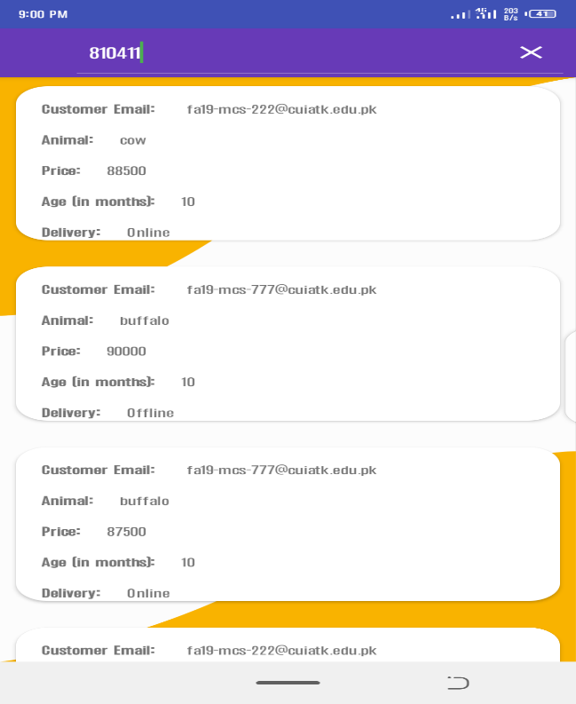
Interfaces
Orders of Animal:
The orders of Animal of a specific Farm is shown below. In which, the Farm Owner can see the Customer Email, Animal, Amount, Price, Age and Delivery choose by the user.

Slide 32
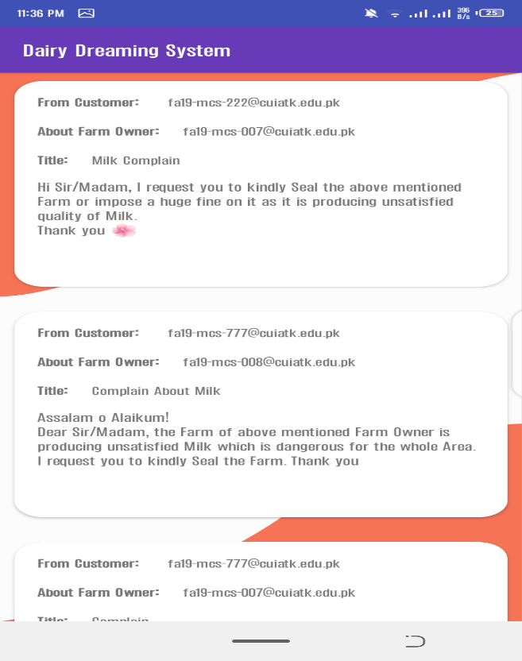
Interfaces
List of all Complained Farm:
The activity below is showing the list of all farms that are complained by the user to the particular Food Authority which will show the Email of Customer and Farm Owner as well as the Title and Message.

Slide 33
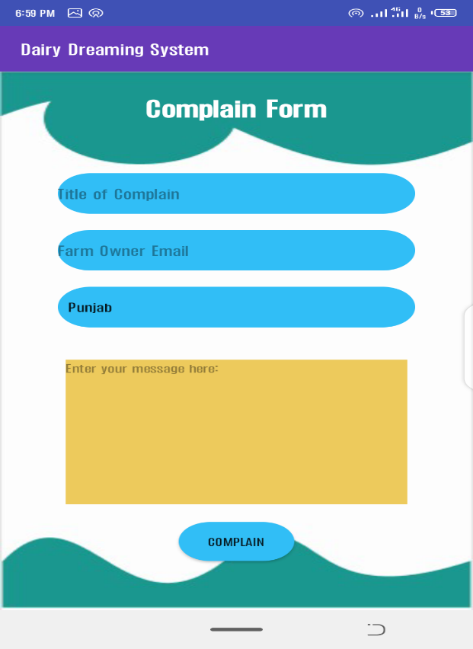
Interfaces
Complain Farm for the User:
The activity below is showing the Complain Form for the user in which, the user has to type his complain to particular Food Authority, about particular Farm with the message.

Slide 34
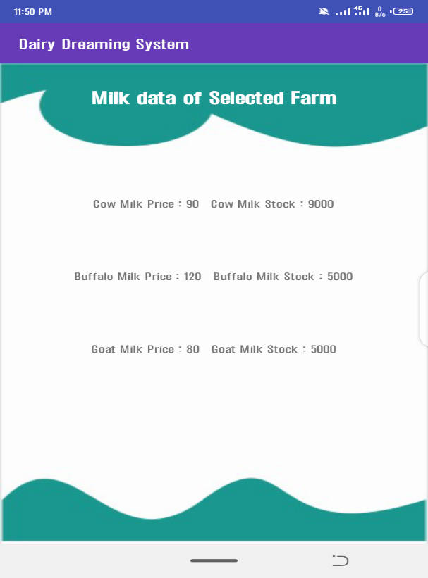
Interfaces
Milk data of selected Farm:
The activity below is showing the stock and price per litre of each Animal type for a particular Farm.

Slide 35
Development Requirements
Software Requirements dependence:
IDE: Android Studio 3.5
Programming languages: Java, JavaScript, HTML and CSS.
Database: Firebase
Tools: Android Studio
JDK
SDK
Hardware Requirements dependence:
Smart Android Mobile Phone or Android Emulator.
_______________________________

Slide 36
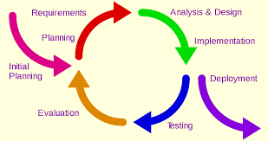
Rationale behind Selected Methodology
The selection of adopting this methodology is Increment forms so that if change require at any point from the Supervisor it must be changed accordingly at proper time and situation.
We are able to provide ease to the user with his/her own wish delivery method i.e., as offline or as online, as supervisor suggests this method.
The supervisor suggests that the user may have ability to complain to Food Authority for ensuring quality product thus we included it.
_______________________________

Slide 37
Modern tools
Tools & Technologies | Purpose
Android Studio | For Designing Interface
Figma | For Designing backgrounds
Firebase | Storing records (Database)
Java/JavaScript | Coding
Android Smart Phone or Emulator | For Testing
MS Word | For Documentation
MS PowerPoint | For Presentation
_______________________________

Slide 38
Benefits
An ease for both the user and farm owner to access each other’s current locations for the effective delivery of the order.
The user can quickly receive acknowledgement (availability /unavailability) about his/her request in the current farm.
The quality and standard product will be ensured as user have a facility to complain to Food Authority in-case of bad standard/quality of milk.
It is the user’s own choice to receive his/her order via offline or online from the farm via location provided by the Google Map.
The main purpose is less time-consumption for the user to easily search his/her order in nearest farm.
After receiving the complains from the user, the Food Authority may then take serious action against that complained farm either seal it impose fine on it.
_______________________________

Slide 39
References
[1] https://studentprojectguide.com/php/milk-dairy-management-system/amp/
[2] https://en.wikipedia.org/wiki/Android_software_development
[3] https://www.youtu.be/EplH-amHTtE
[4] https://www.youtu.be/qK0QNA0sMGc
[5] https://firebase.google.com/docs/database
[6] https://abhiandroid.com/programming/googlemaps
[7] https://firebase.google.com/docs/database/android/read-and-write
[8] https://www.tutorialspoint.com/android/android_google_maps.htm
_______________________________

Slide 40
Thank You!
The End

